Slide 1

Health Status Prediction
1st Iteration Presentation
Sarah Price Ruth Whitehouse Shababa Kamreen Lillian Sheppard

Slide 2



Agenda
Project Introduction Presented by Team Manager Sarah Price
Managing the Data Presented by Lead Data Modeler Ruth Whitehouse
Visualization: A Closer Look Presented by Co-Visualizer May Kamreen
Visualization & Github Repo Presented by Co-Visualizer Lillian Sheppard

Slide 3

Project Introduction
Presented by Sarah Price

Slide 4




Meet the Team!
Sarah Price
Ruth Whitehouse
Shababa Kamreen
Lillian Sheppard
Team Manager Lead Data Analyst
Client Liaison Lead Data Modeler
Visualizer Scrum Master
Visualizer Project Scribe

Slide 5
What exactly are we working on?
Project Description
Our Main Goal
Relating it to the real world…
TECHNOLOGIES
Create an EXPLORATORY visual that is both engaging and informative to a user about Heart Disease based on input symptoms!
Create an INTERACTIVE visual!
Shows the correlation between the most common Heart Disease symptoms and their Heart Health Status.
Disclaimer: the model we create is exploratory and should not be used as a replacement to a health care professional.
Python
Vue*
Plotly
SAP Analysis/HANA
Tableau*
D3.js
JSON*
*Subject to change!

Slide 6
Project Timeline
Week 1 (1/25-1/31)
Team formation
Create Project Charter
Week 2 (2/1-2/7)
Gather datasets
GitHub Repo
Formulate Hypothesis
Weeks 3 & 4 (2/8-2/21)
1st Iteration: Present Team Plan, Technologies, Collections, and GitHub Repo
Week 5 (2/22-2/28)
Performance, Scalability, and Efficiency
Work on Project Visualizations
Week 6 (3/1-3/7)
Look for Simple Patterns that Align to Project Goals
Week 7 & 8 (3/8-3/28)
2nd Iteration: Clean data collections, Insights/Patterns, Hypothesis, Tableau/Visualize
Weeks 9 & 10 (3/29-4/11)
Build a Predictive Model
Week 10 (4/12-4/25)
Final Project Demo
CREATE Symposium
Final Project Report
Assign Project Roles

Slide 7

Project Flowchart
Life Cycle
1. Formulate Hypothesis
II. Collect Datasets
III. Clean Data
IV. Create Model
V. Test Model
VI. Deploy Model
COMPLETE!
We are HERE!
NEXT STEP!

Slide 8

Managing the Data
Presented by Ruth Whitehouse

Slide 9
Our Plan for the Data…
DATA COLLECTIONS!
Our plan for data cleansing…
4 DATASETS!
Each dataset focuses on specific attributes that influence the status of a Health Heart!
Use SAP Analysis and Tableau to clean the data*
Eliminate EMPTY columns
Eliminate NULL values
PULL similar columns across ALL datasets
Store the data in JSON*
*Subject to Change!

Slide 10
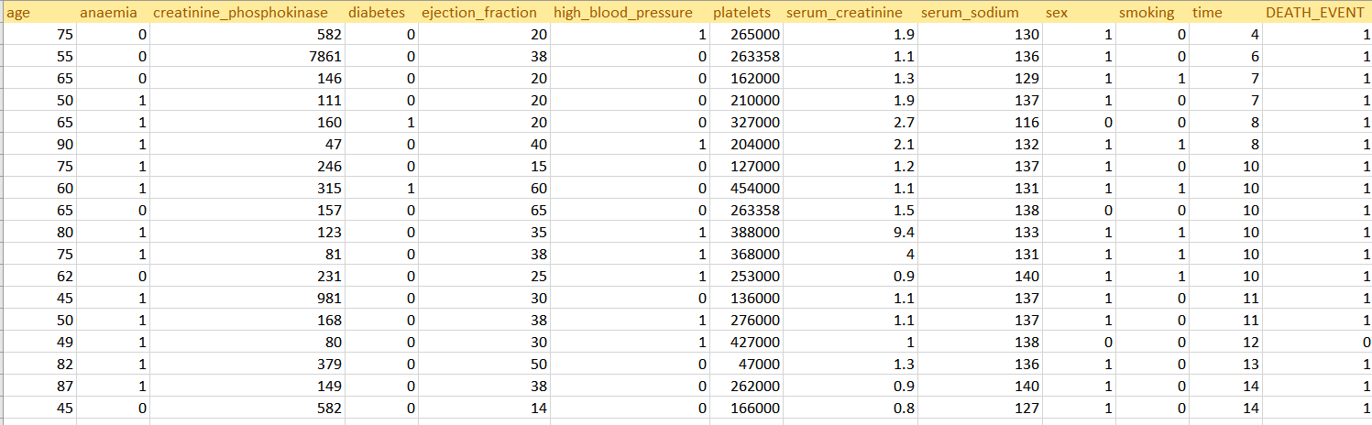
Dataset 1: heart_failure_cliniacal_records_datasheet.csv
Location: U.S.
Year: 2020
File Type: CSV
Source: Kaggle
# of Attributes: 12
# of Records: 299

Slide 11
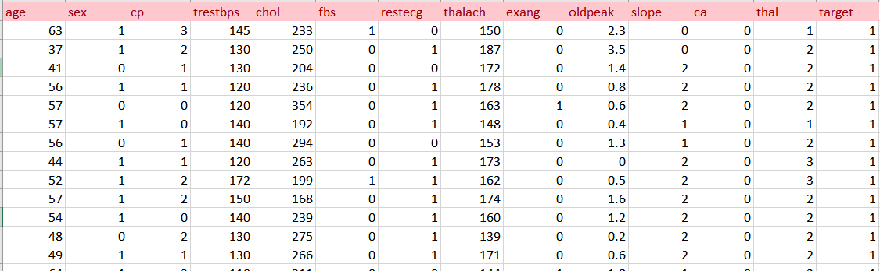
Dataset 2: heart.csv
Location: U.S.
Year:
File Type: CSV
Source: Kaggle
# of Attributes: 14
# of Records: 303

Slide 12
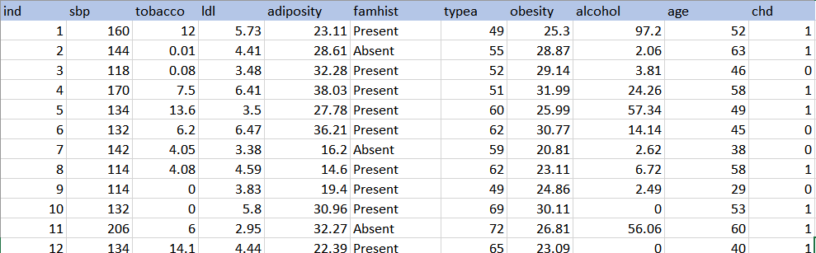
Dataset 3: heart_disease.csv
Location: South Africa
Year: 1989
File Type: CSV
Source: Kaggle
# of Attributes: 11
# of Records: 462

Slide 13
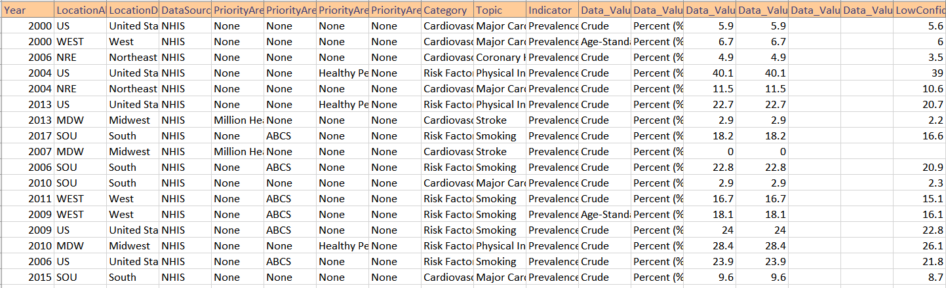
Dataset 4: National_Health_Interview_Survey_NHIS_National_Cardiovascular_Disease_Surveillance_Data.csv
Location: U.S.
Year: 2000-2020
File Type: CSV
Source: National Health Interview Survey
# of Attributes: 28
# of Records: 15,840

Slide 14
Hypothesis Formulation Plan!
Our plan is to create multiple ALTNERATIVE HYPTHOSESIS* that explore multiple risk factors.
Example: The higher [i.e., cases of tobacco/alcohol abuse], the more likely they are to have Heart Disease.
*Subject to Change!

Slide 15
Statistical Analysis Plan!
Explore the Mean, Mode, Range, etc.
Example: The average Obesity Rate was…
Example: How many cases come out positive for Heart Disease because of [i.e., Obesity].
Explore correlations with our symptoms and Heart Disease!

Slide 16

Technology & Visualization
Presented by Shababa “May” Kamreen

Slide 17
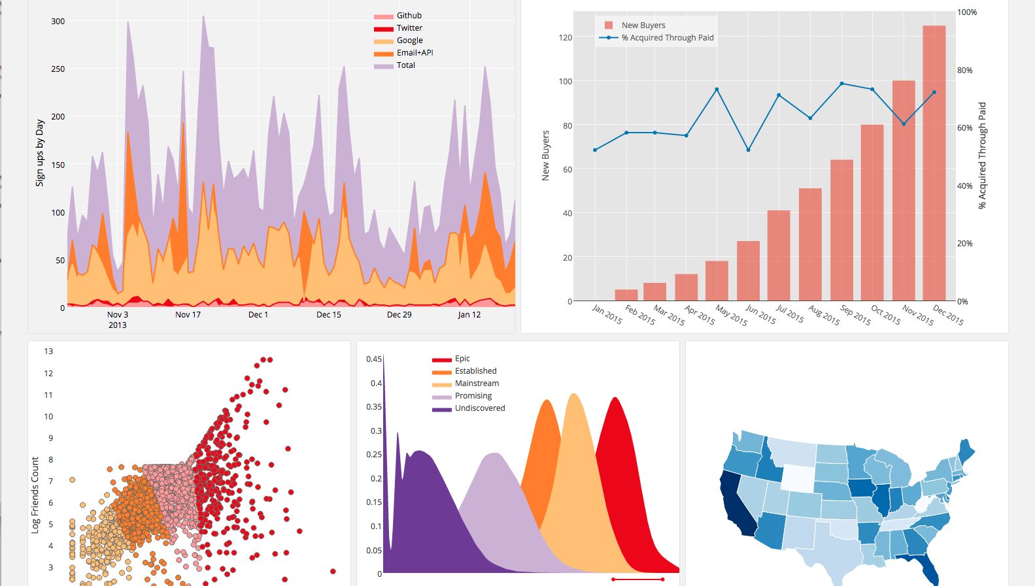
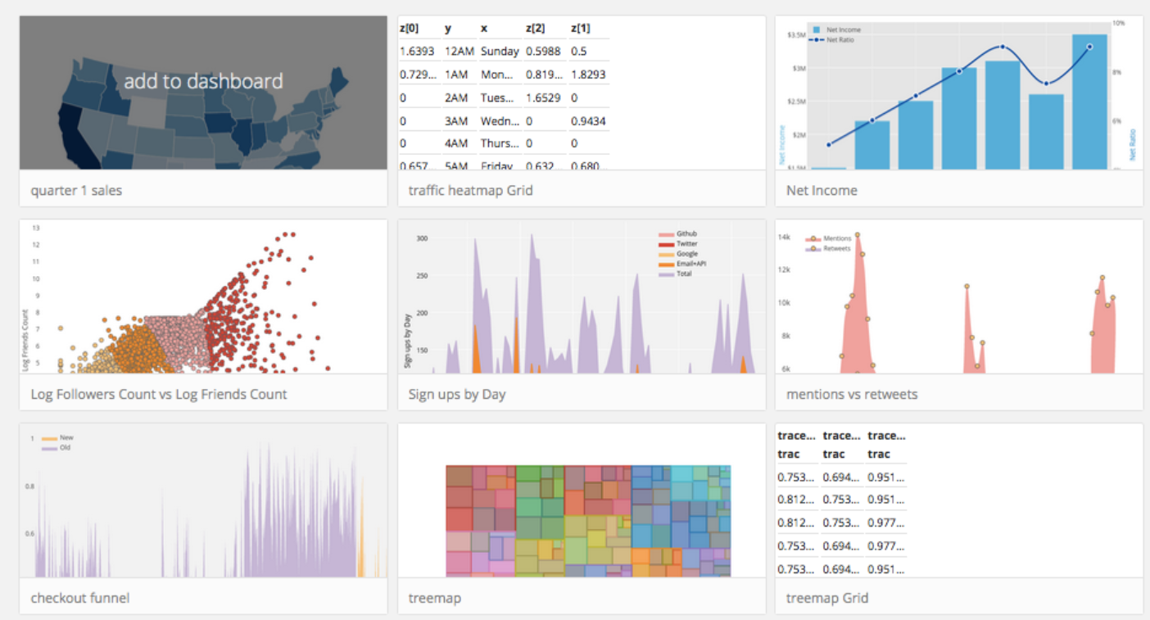
Plotly & D3.JS!
Explore visuals for Statistics!
Make it Interactive!

Slide 18

Technology & Visualization Cont.
Presented by Lillian Sheppard

Slide 19
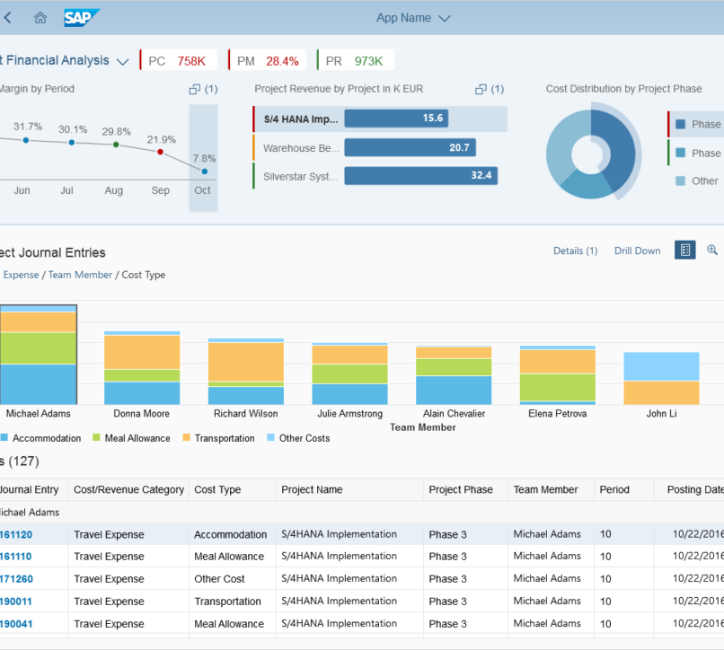
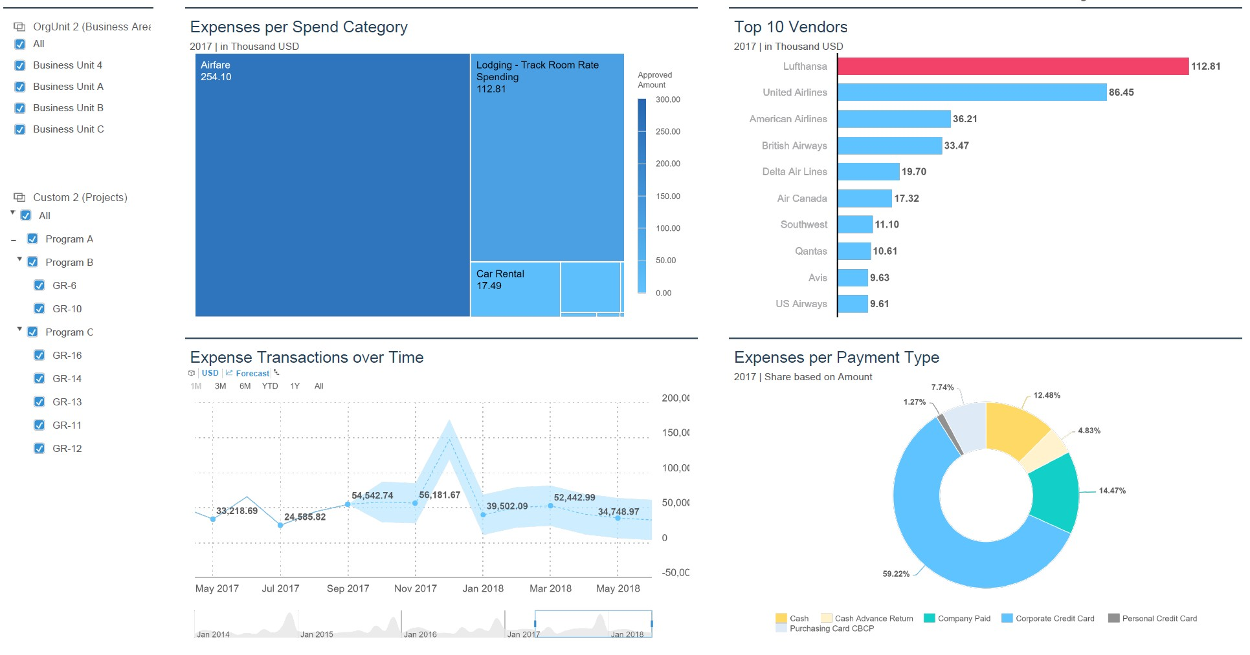
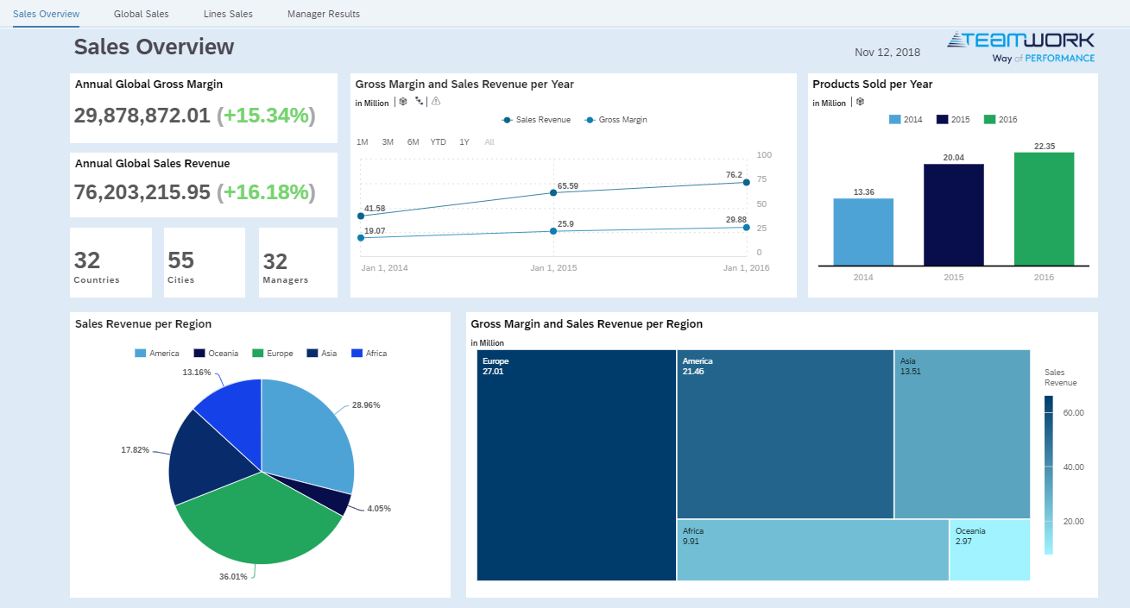
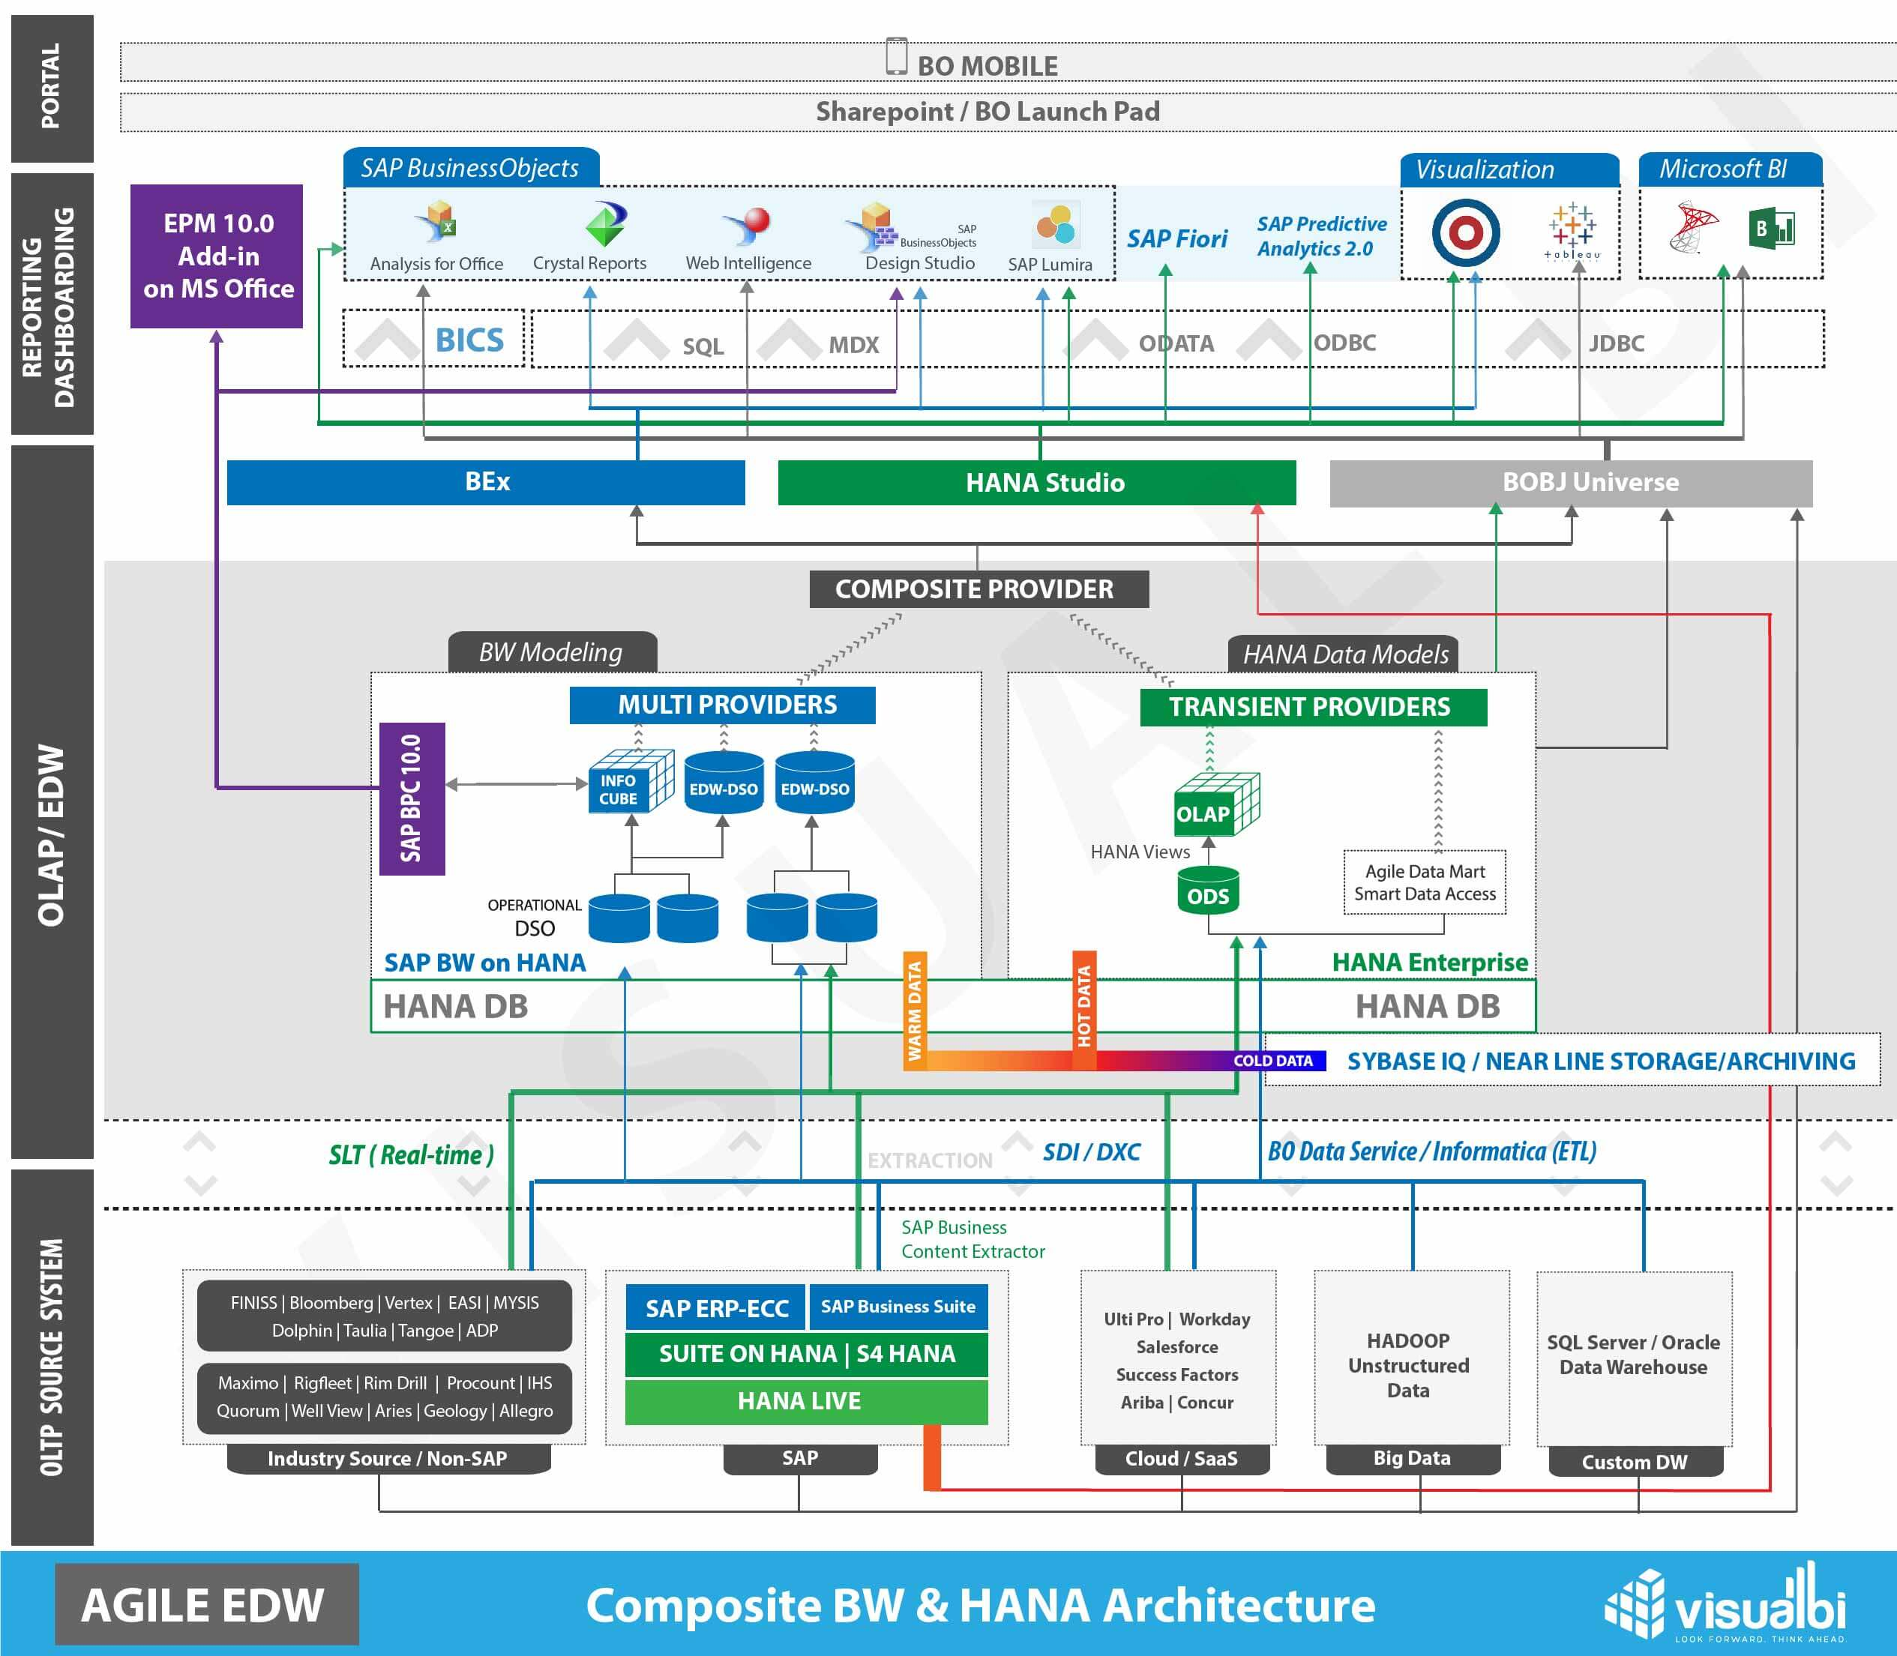
SAP Analysis
Our goals for User Interaction.
Exploring visualizations for Heart Disease​!
Notes:
When a user interacts with out model, we want it to be visually engaging (which we plan on using Plotly and D3.JS for) but also informative... and that's where we hope to utilize SAP Analysis.

Slide 20
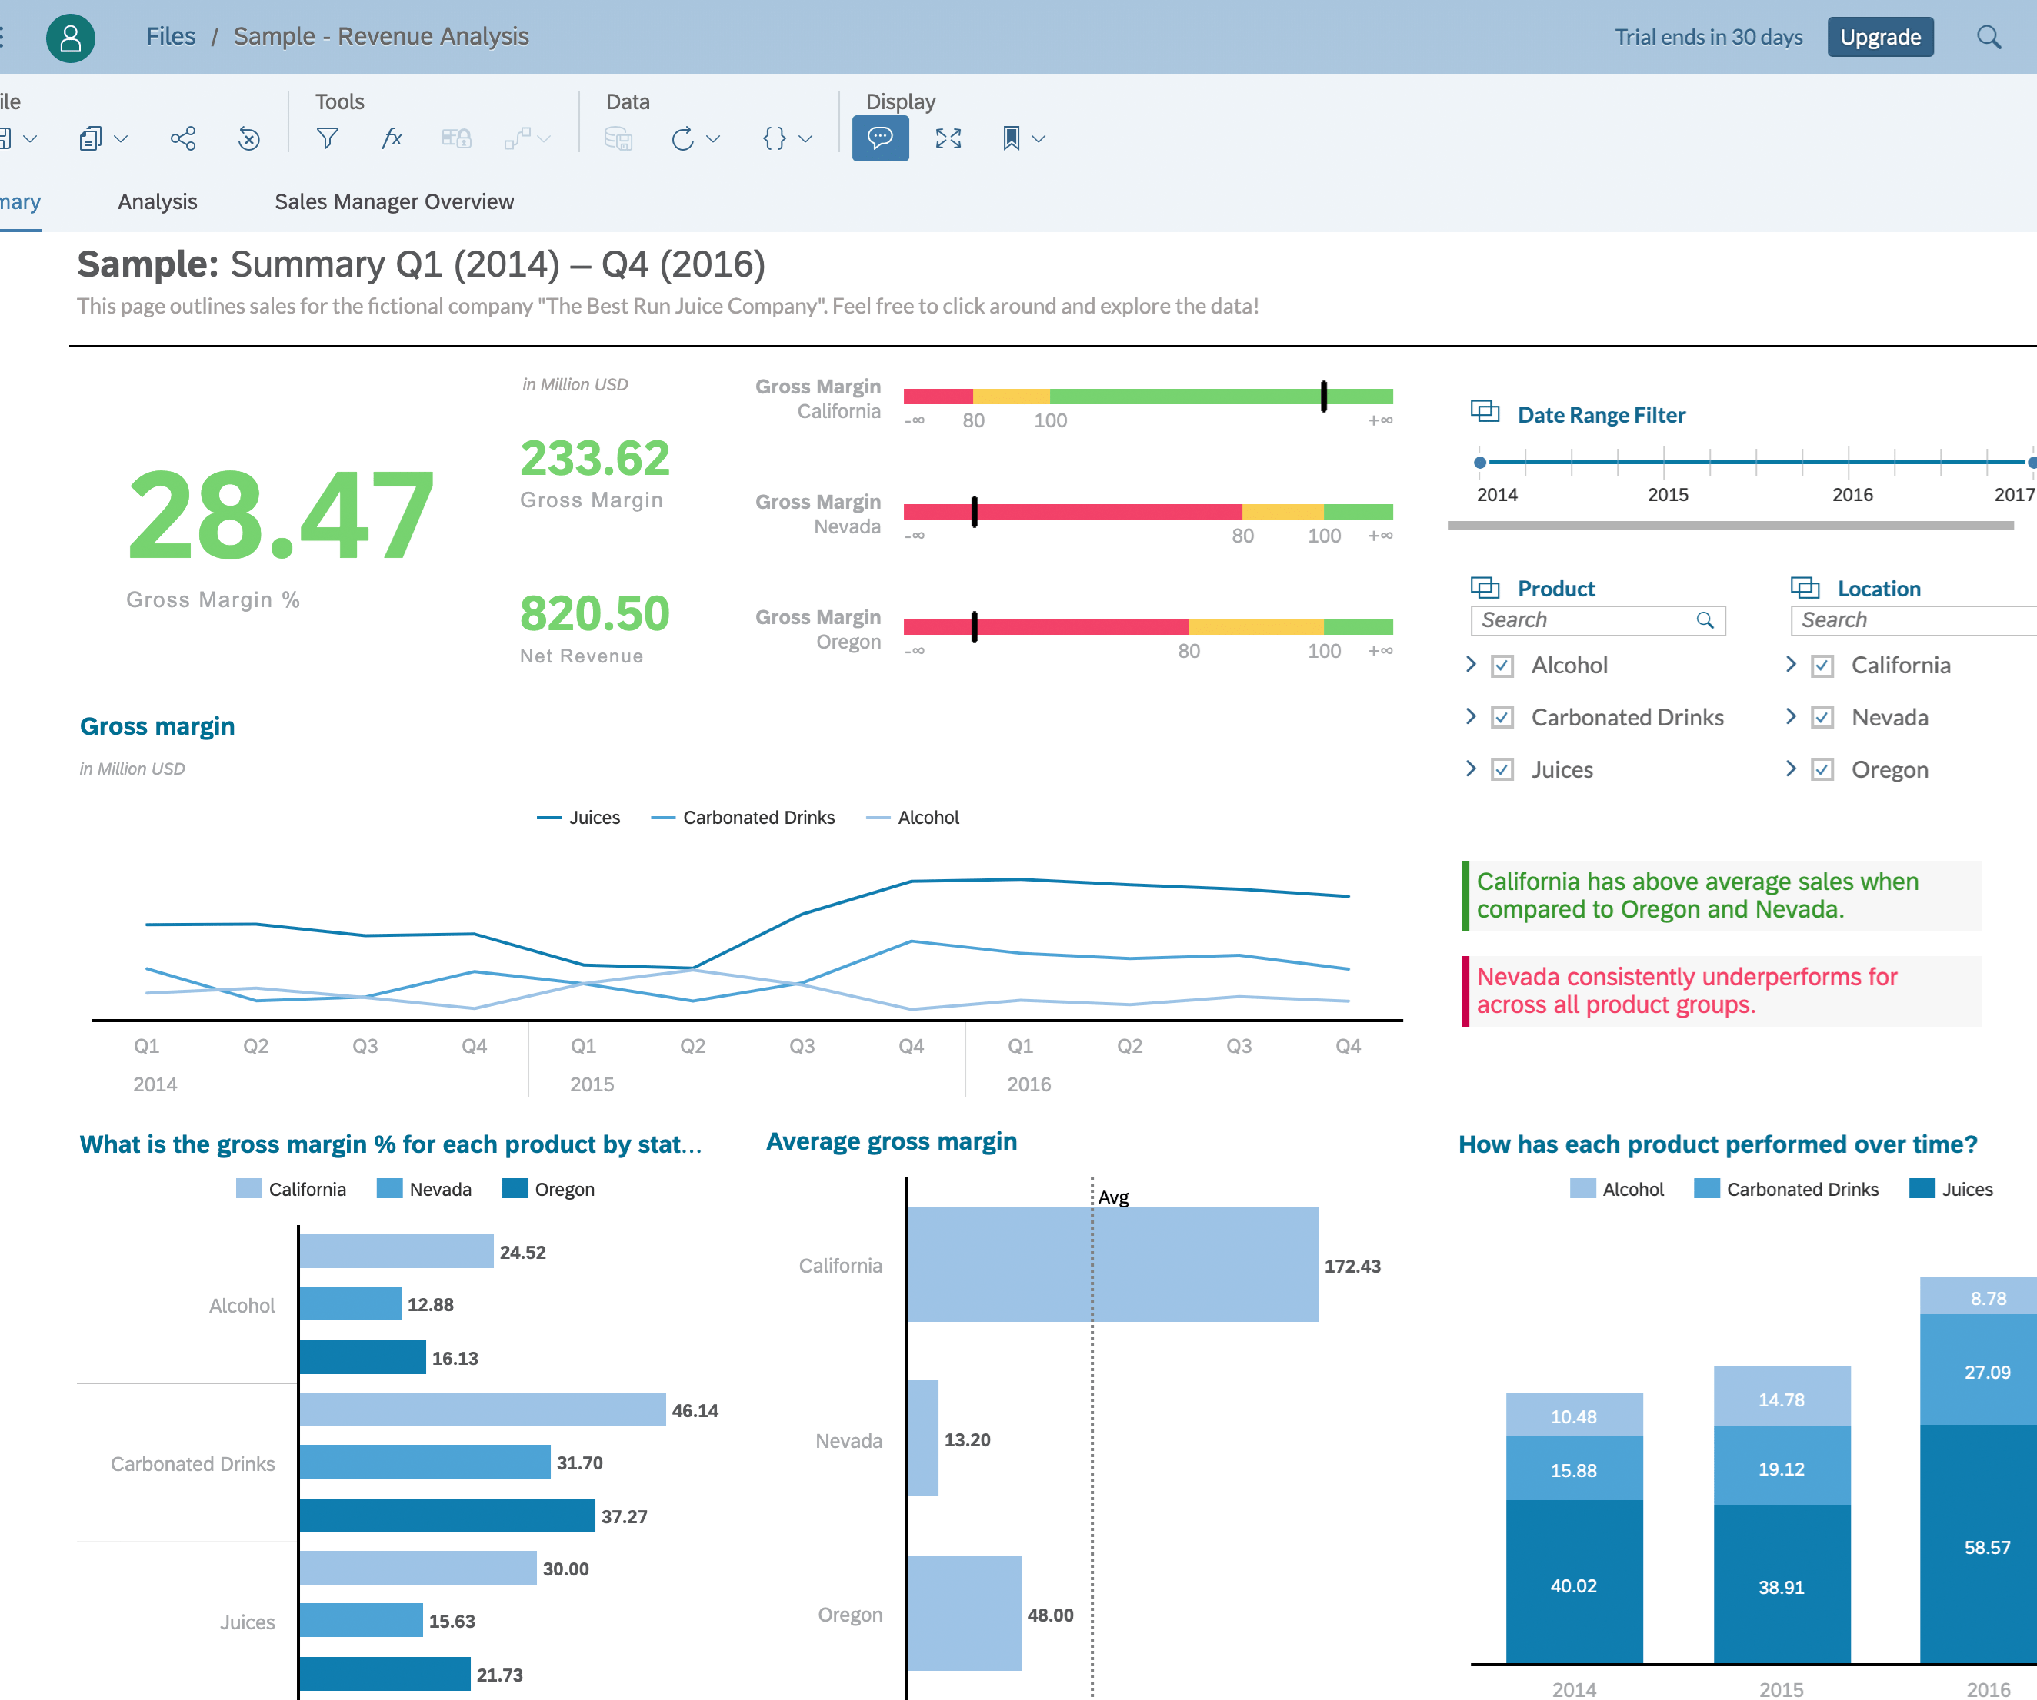
Example
Visually Engaging VS Informative
Benefits!
Notes:
The picture on the right is an example of what we ideally want to present to the user as a closer look to Heart Disease and the attributes that influence it.​
​
Benefits to using SAP Analysis as both an analytical tool and a visual aid: ​
​
1. SAP provides Real-Time Analysis.​
2. Data can be directly and quickly processed.
3. You can access various databases at the same time for both transaction and analytical queries.
4. Provides Parallel Processing which means we can apply one operation to all the datasets at the same time.
5. Performs Data and Integration and Aggregation from various data sources at the same time!

Slide 21
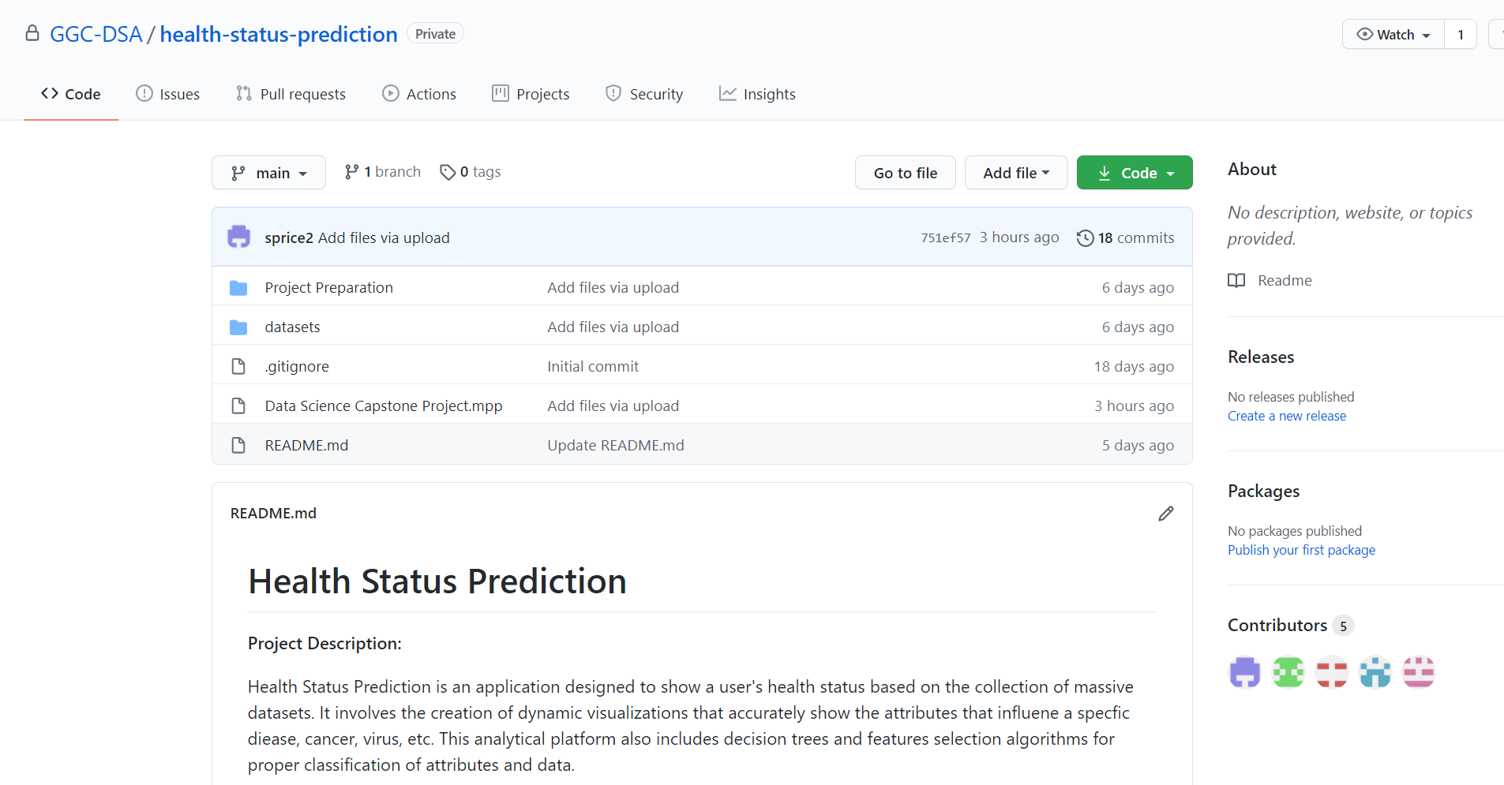
Github Repo
+ Documentation
Notes:
This is a depiction of our current Github Repo.
We have two important folders. One called Project Preparation which contains our Charter, Timeline, and Flowchart.
The other is called datasets, which contains our data collections.
The is one more folder we plan to create called Documentation which will be where we keep all our important documents, and Scum Meeting Minutes AS WELL AS project FEEDBACK, so our first document will be our 1st Iteration plans along with sponsor feedback.

Slide 22


Thank You!

